Slide 1
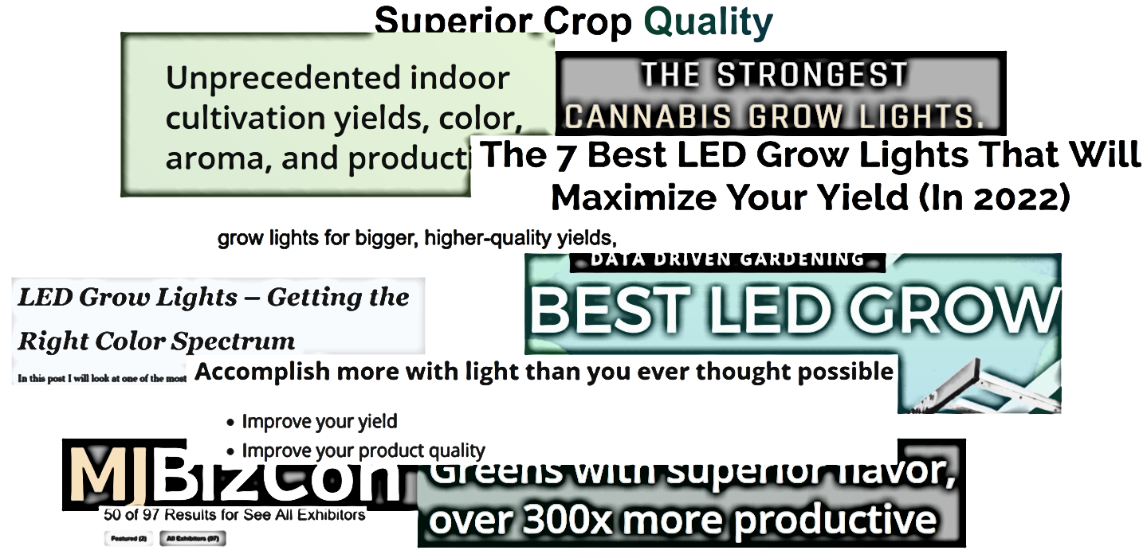
What To Look For in LED Horticulture Fixtures
?

Slide 2
As a cultivator, you know that one of the most critical inputs into Controlled Environment Agriculture (CEA) is the lighting.
There are endless choices of LED fixtures available at varying price points, performance levels, and marketing claims.
How do you know what lighting choice is the smart move?
This guide will help you differentiate LED horticulture fixtures and break down what is important, so you can choose the right light for you and your business.

Slide 3
LED Horticulture Lighting – Comparison Points
The Lighting Manufacturer
Basic Fixture Design
Fixture Components
LEDs, Drivers
Overall Fixture Design
Design Light Consortium Listed
Fixture Performance (Output/efficacy)
Controls
Spectral Distribution

Slide 4
Assess the Lighting Company
How established/reputable is this lighting company?
How long have these companies been making LED fixtures?
Will this company be around to honor the product warranty?
Are you confident this company will pick up the phone if you have issues?
Do the products from this company perform as claimed? How do you know?
Where do the products come from?
Is there research/grower’s input driving the development of the products?
While a bargain price from a largely unknown entity may be attractive, it may leave you in a serious jam down the road. Especially if they are no longer in business.

Slide 5
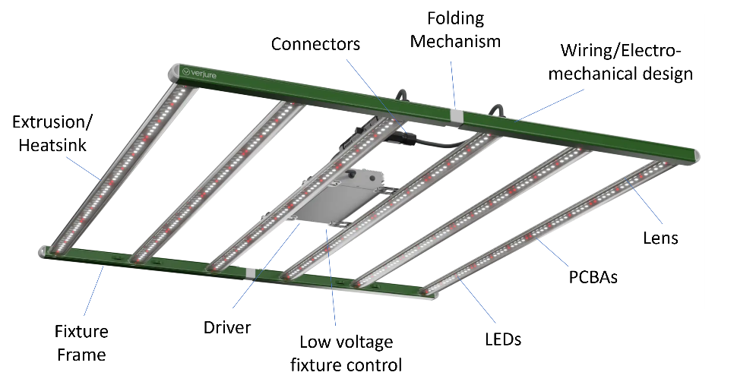
Basic Fixture Design Components

Slide 6
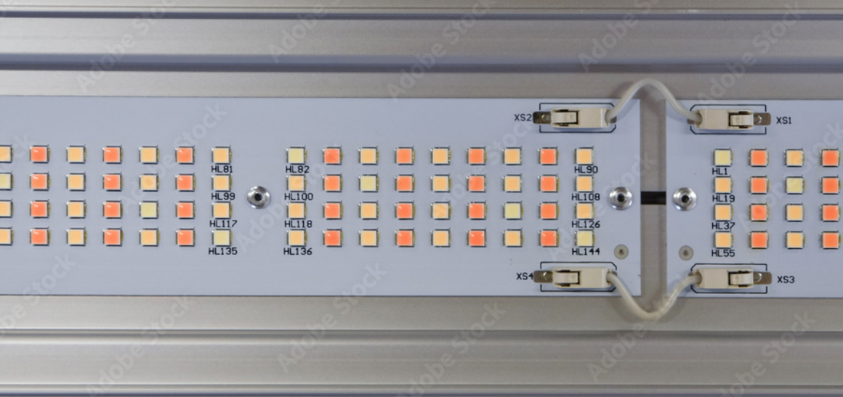
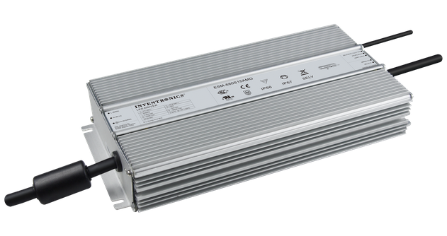
Fixture Components
Many lighting fixtures may look similar from an aesthetic standpoint, there can be a huge variation in the quality of components used in the light that can impact the performance, reliability, and longevity.
LEDs
Drivers

Slide 7
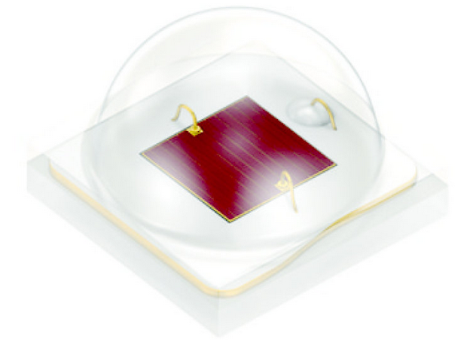
Fixture Components – LED
There is a huge variation in the quality of horticulture LEDs on the market
The design and quality of the LED will impact light output, efficacy, and Photon Flux Maintenance (Q90)
Choose a product that uses the latest LEDs from trusted “Tier 1” suppliers with established track records Samsung, Osram, Nichia, etc.
Some lighting products are even reported to use “look-alike” generic LEDs – beware!
The higher quality LEDs have a higher cost, but can offer superior performance, robustness, lifetime, and thermal resistance. Be weary of products that claim huge performance at a “too good to be true” price!

Slide 8
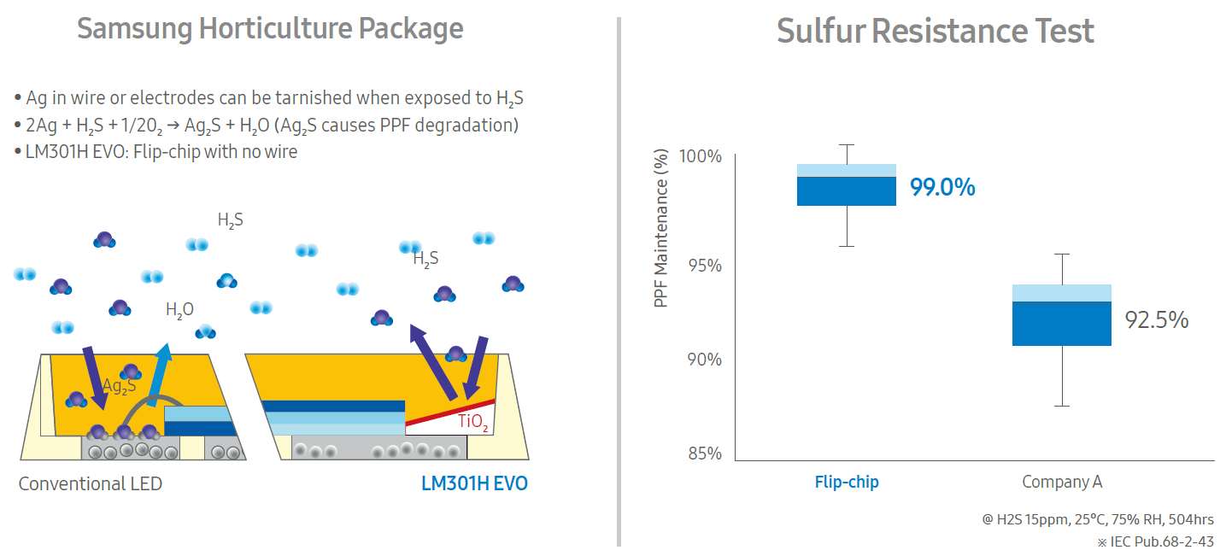
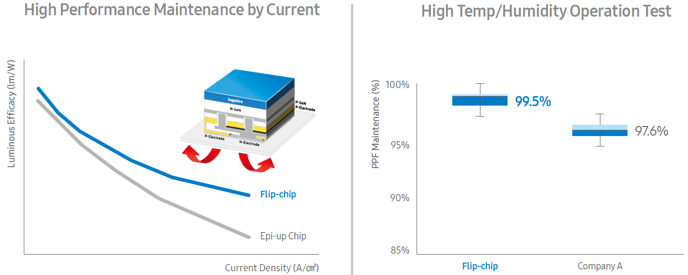
Fixture Components – LED
Examples of differences in LED chemical resistance and light output between Samsung and another LED
Depending on which LED is used, the light output could very greatly over time in real world conditions

Slide 9
Fixture Components - Drivers
90% of lighting failures are driver-related
Common causes of failure can be electrical overstress, surge events, harmonics, etc. (dirty power)
Look for a fixture that offers 6kV Surge Protection to ANSI Standards
Look for a fixture where the driver is designed to be replaced/serviced!
Considering a fixture that is listed on DLC will ensure you are getting minimal acceptable driver life
Commodity grade fixtures may use commodity grade drivers
Note – some fixtures may have drivers that only allow for min dim levels of 40-50%

Slide 10
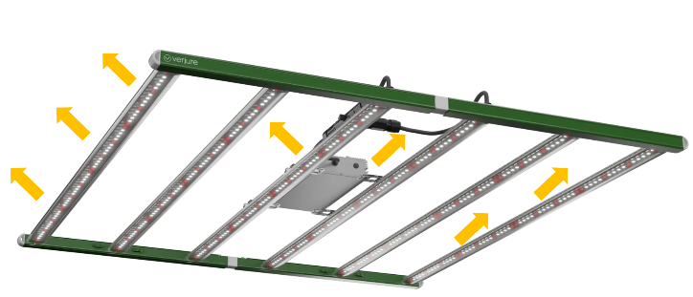
Fixture Ambient Temperature Listing
UL temp listings are driven by internal operating temperature of components (LEDs, drivers, etc.)
Look for a UL listing of 35C to 40C+ (95F to 104F)
Basic concepts that drive higher ambient listing:
  Larger qty of LEDs driven at a lower current
  Isolated Driver
  Isolated Light Bars
  Heatsinking method of PCBA to extrusion
The higher the wattage, the more heat produced
  3.41 BTU’s / watt
The lower the efficacy of the fixture, the higher the heat generated at a given light output

Slide 11
Other Fixture Design Considerations
Many fixtures may look alike but there are some design features that could be very important to you and how it performs in your space
Passive heat management (no fans). Fans signal old-school technology, and should be avoided
IP rating – Seek IP66 rated or better.
Fixture serviceability – Know if the fixture is designed to allow the boards and drivers to be changed and serviced
Cleanable Lenses – Lenses protect the LEDs and can easily be wiped down to help maintain maximum light output
Fixture Size/Dimensions – May contribute to uniformity on the canopy
LED count – More LED’s on the board could mean lower temps for each LED, leading to longer life.

Slide 12


Design Light Consortium
Look for products listed on Horticulture DLC Qualified Product List
This is your best bet to ensure the product you are buying performs (output/efficacy/life/etc) as advertised on the marketing brochure or spec sheet
DLC reviews and validates testing of samples by 3rd party labs
DLC requires minimum efficacies, driver life, LED life, etc
Be aware of products that claim DLC on their spec sheet, but are not listed on the DLC. This is not uncommon!
Be aware of products that claim higher performance than what is listed on DLC. This is not uncommon!
DLC is updating their technical reqts to V3.0 in 2023
  Higher efficacy reqts > 2.3 μmol/j

Slide 13
Fixture Output PPF (Photosynthetic Photon Flux)
1000W DE HPS roughly delivers 1800 μmol/s (initially)
LED fixtures with lower output that claim to replace 1000W DE HPS are relying on claimed “spectral” improvements to make up the difference, or moving the light closer to the plants
Fixture output on spec sheet should match what is listed on DLC Horticulture QPL

Slide 14
Fixture Efficacy (μmol/j)
Look for efficacies > 2.5 μmol/j for broad full spectrum
Make sure you know the efficacy of the spectrum you are interested in
Some fixtures advertise ultra-high efficacies, but note that these may be only available on all red LED spectral options, not full spectrum
Efficacy on spec sheet should match DLC (in most cases)

Slide 15
Fixture Longevity
Photon Flux Maintenance (Q90) tells you how many hours the fixture will deliver > 90% of its initial photon output per LM80/TM21 methodologies
DLC min Q90 > 36,000 Hours
Top tier Fixtures will deliver Q90> 50,000 Hours, documented per TM21/LM80 methodologies
Q90 50,000 vs 36,000 could be 3+ years more of light at 90%+ of initial output
Look out for fixtures that claim ultra long hours without providing documented photon flux maintenance
For example – take the vague lifetime claim below. Is this 90% of initial photon output? 70%?

Slide 16
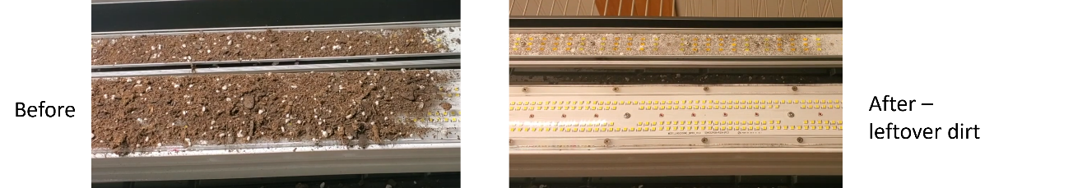
Fixture Longevity - LED Protection/Lensing
LED protection via cleanable lenses may help maintain output
It is never recommended to wipe down bare LEDs with a rag or cloth
A cleanable, replaceable lens will help protect the LEDs during staging and installation, and keep the LEDs cleaner over time, delivering higher output to your canopy
Most LED PCBAs are conformal coated, which can be tacky
This can reduce LED efficacy and output over time
Below shows how dirt can stick to the conformal coating of a bare LED, even after wiping down the board

Slide 17
Fixture Controllability
The latest LED controls technology allows for the fixtures to be wirelessly controlled and individually addressable, without the need to run any additional wiring to the fixture
The latest wireless controls are robust, reliable, and may offer significant advantages such as
Reduced installation time
Reliable, secure communication
Flexibility to group/zone/recommission your space
Scalable
Compatible with other environmental controls systems
Data analysis, power metering etc
Remote-based control capabilities

Slide 18
Spectral Distribution
For many fixtures on the market, cost and imitation drives the spectral makeup, not plant research or science
There is no such thing as the “perfect spectrum” for all plants
More research is needed to understand full impacts of all spectra on plants (UV/Far Red/Tunable/etc.).
Which Plants? Which spectrum? At what intensity? At what growth stage? For How Long? What environment?
Be weary of claims of the perfect or magic spectrum that supposedly delivers vastly increased yields or quality
These types of results are often from optimizing an entire grow operation along with new higher intensity lighting, which can cloud the data. Much data showing light intensity has larger impact than spectrum
Look to available academic and science research for the plant you are growing, not marketing claims
  https://www.acuitybrands.com/verjure-horticulture-lighting/research

Slide 19
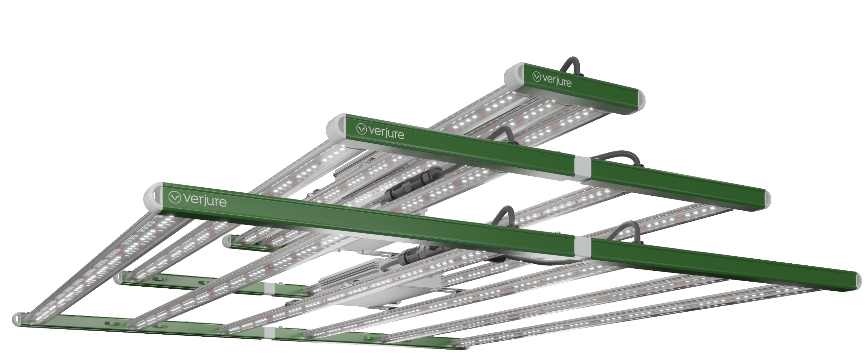
Versatile Solution
  Verjure Pro Series LED features the Verjure Full Range Spectrum® and can be used for cannabis, floriculture, fruits/veggies, greens, etc
  Applications: Greenhouse, Indoor Cultivation, Vertical
Powerful Specs and Options
  Up to 1880 μmol/s, 2.8 μmol/j performance
  Smart mechanical design – IP66, rotatable optics, easy-clean lenses, 6kV Surge
  nLight Air enabled – wireless controls
Trusted Performance
  Developed using academic-based cannabis research
  Lighting performance independently tested in 3rd party labs
  100% end-of line-tested to ensure product quality
  Samsung/Osram Tier 1 Horticulture LEDs
We Can Deliver
  10-day lead time, Produced in N. America
  Scale to support any opportunity
Customer Support
  Plant/cultivation experts to assist your customer
  Horticulture lighting layouts/design support
Trusted Partner
  We’ve been in business for over 75 Years, and you can count on us being here for your customer to support the warranty

Slide 20
Quick Fixture Checklist
Considerations | Target
Lighting company history: | Years+ of established track record – Is there a customer service number?
Lighting company resources: | Can they run photometric layouts? Can they assist with cultivation questions/tech support questions
Fixture warranty: | 5 years, backed by a reputable company
What fixture components are used? | Tier 1 name brand LED and Driver components from reputable suppliers
Fixture performance to match 1000 w DE HPS: | Min of 1800 µmol/s for 1-1 replacement of 1000 W DE HPS
Fixture efficacy (in a broad spectrum): | Min of 2.5 µmol/j
Does the fixture have validated performance? | Is it on DLC? Do they list 3rd party lab testing?
Are the claims backed up by credible sources? | Is any research cited? Any credible resources?
Is the fixture serviceable? | Serviceable boards and drivers
Controllability? | Are wireless controls available? What is the min dim level of the fixture?
What is the max ambient temp of the fixture? | UL listed to a min of 35C to 40C (104F)
What is the PPF maintenance of the fixture? | Q90> 50,000 Hours, using LM80/TM2
Does the fixture offer a lens? | Keeps LEDs clean, maximize light output over time
IP rating of the fixture: | IP66
Fixture lead time: | If made overseas, it could be many weeks on volume orders

